Slide 1

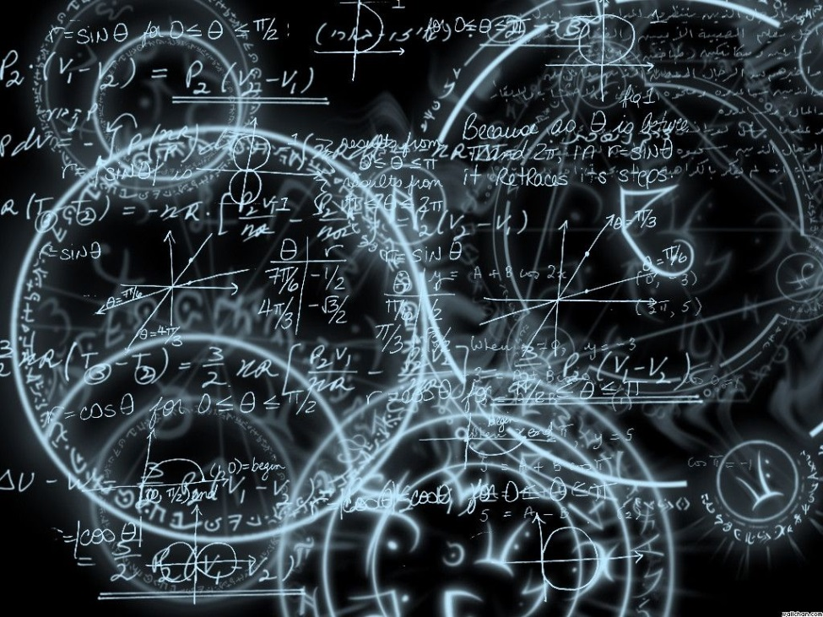
Azərbaycan Dövlət Neft və Sənaye Universiteti
Calculus
Single Variable

Slide 2
Implicit Differentiation:
Implicit and Explicit Functions

Slide 3
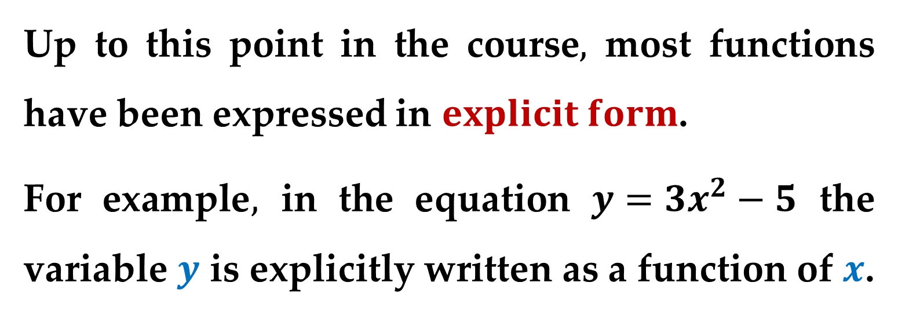
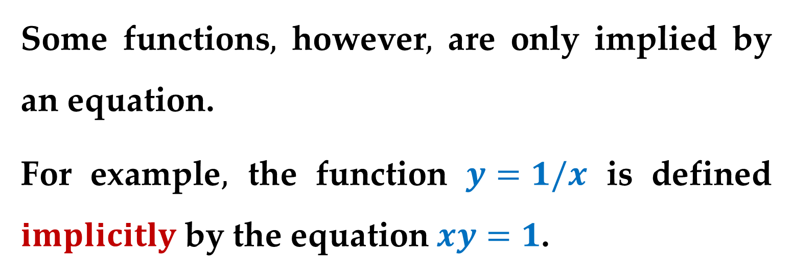
Up to this point in the course$,$ most functions have been expressed in $explicit form$.
For example$,$ in the equation $y=3x^{2}−5$ the variable $y$ is explicitly written as a function of $x$.
Some functions$,$ however$,$ are only implied by an equation.
For example$,$ the function $y=1/x$ is defined $implicitly$ by the equation $xy=1$.

Slide 4
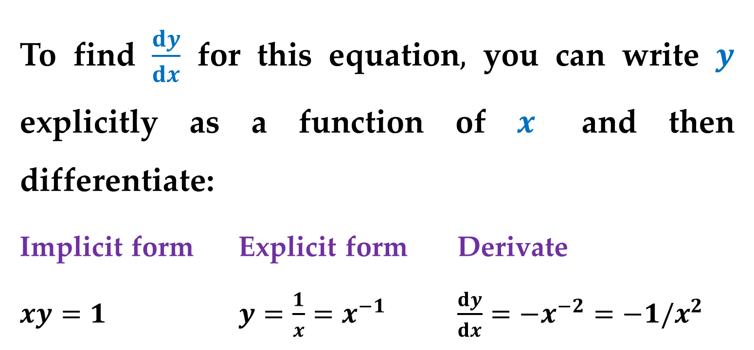
To find $\frac{dy}{dx}$ for this equation$,$ you can write $y$ explicitly as a function of $x$ and then differentiate:
Implicit form Explicit form Derivate
$xy=1$ $y=\frac{1}{x}=x^{−1}$ $\frac{dy}{dx}=−x^{−2}=−1/x^{2}$
This strategy works whenever you can solve for the function explicitly.

Slide 5
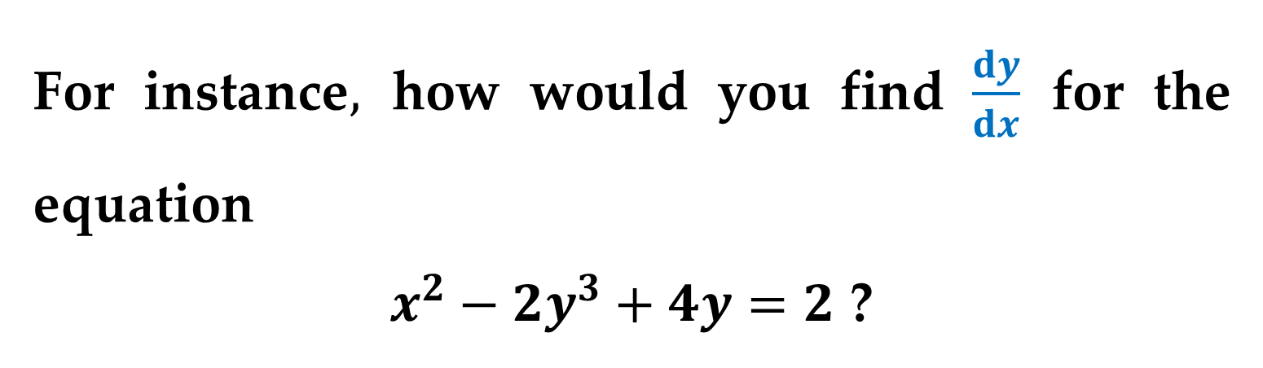
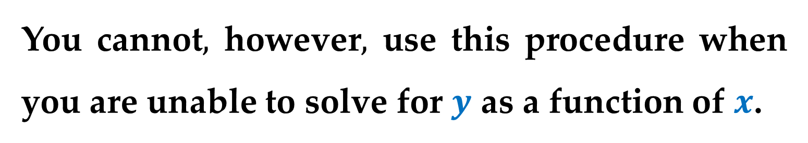

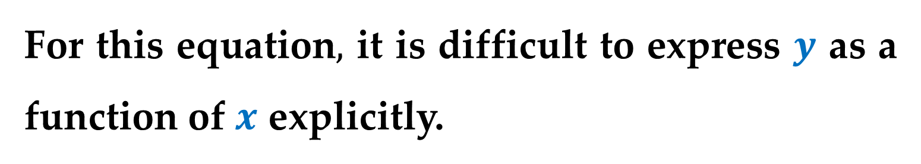
You cannot$,$ however$,$ use this procedure when you are unable to solve for $y$ as a function of $x$.
For instance$,$ how would you find $\frac{dy}{dx}$ for the equation
$x^{2}−2y^{3}+4y=2$ ?
For this equation$,$ it is difficult to express $y$ as a function of $x$ explicitly.
To find $\frac{dy}{dx}$ you can use $implicit differentiation$.

Slide 6
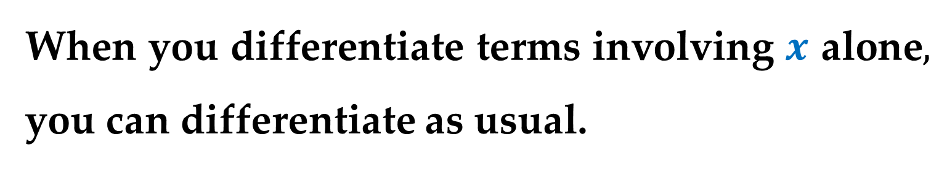
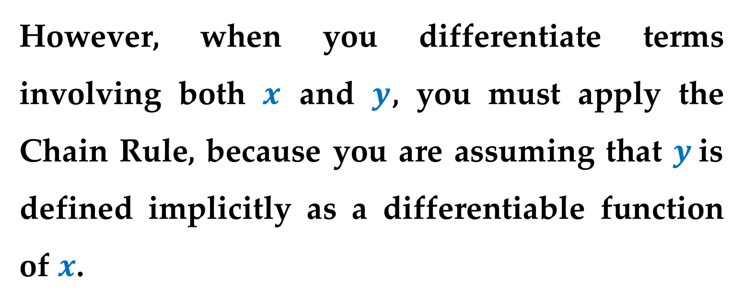
When you differentiate terms involving $x$ alone$,$ you can differentiate as usual.
However, when you differentiate terms involving both $x$ and $y$, you must apply the Chain Rule, because you are assuming that $y$is defined implicitly as a differentiable function of $x$.

Slide 7
Example 1. Differentiating with Respect to x
a. $\frac{d}{dx}\left[x^{3}\right]=3x^{2}$ $Variables agree:use Power Rule$
Variables agree
b. $\frac{d}{dx}\left[y^{3}\right]=3y^{2}\frac{dy}{dx}$ $Variables disagree:use Chain Rule$
Variables disagree
c. $\frac{d}{dx}\left[x^{2}+3y\right]=2x+3\frac{dy}{dx}$ $Power Rule+ Chain Rule$

Slide 8
Example 1. (continued)
d. $\frac{d}{dx}\left[xy^{2}\right]=x\frac{d}{dx}\left[y^{2}\right]+y^{2}\frac{d}{dx}\left[x\right]$ $Product Rule$
$=x\left(2y\frac{dy}{dx}\right)+y^{2}\left(1\right)$ $Chain Rule$
$=2xy\frac{dy}{dx}+y^{2}$ $Simplify$

Slide 9
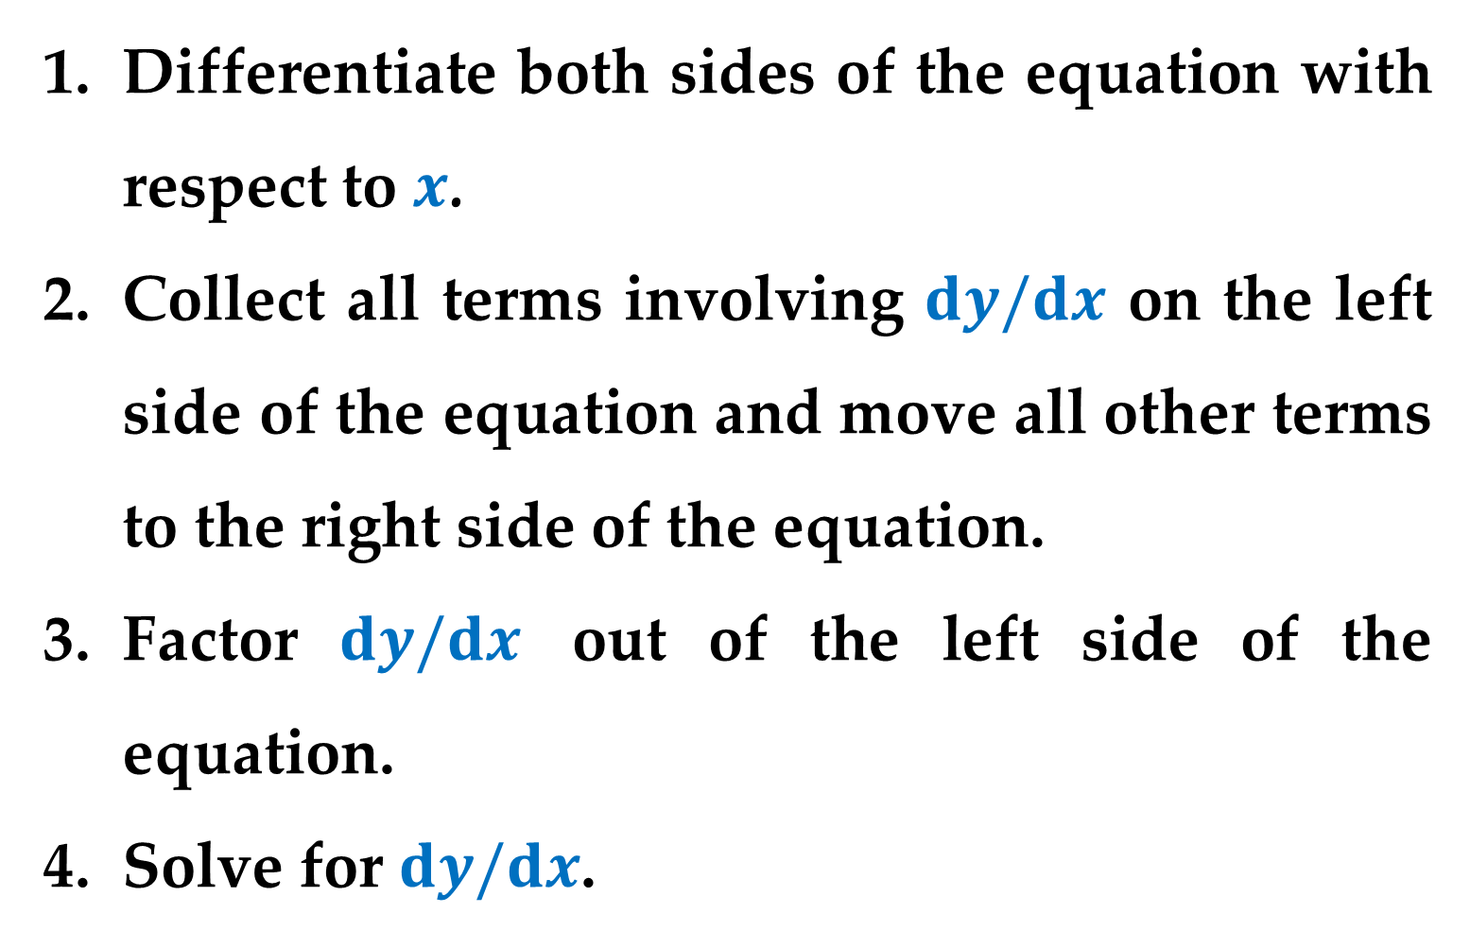
Guidelines for Implicit Differentiation
Differentiate both sides of the equation with respect to $x$.
Collect all terms involving $dy/dx$ on the left side of the equation and move all other terms to the right side of the equation.
Factor $dy/dx$ out of the left side of the equation.
Solve for $dy/dx$.

Slide 10
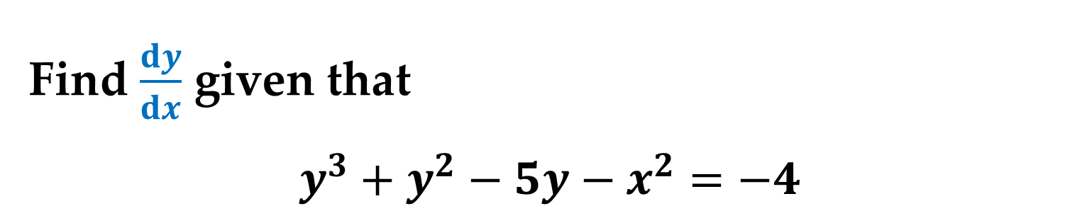
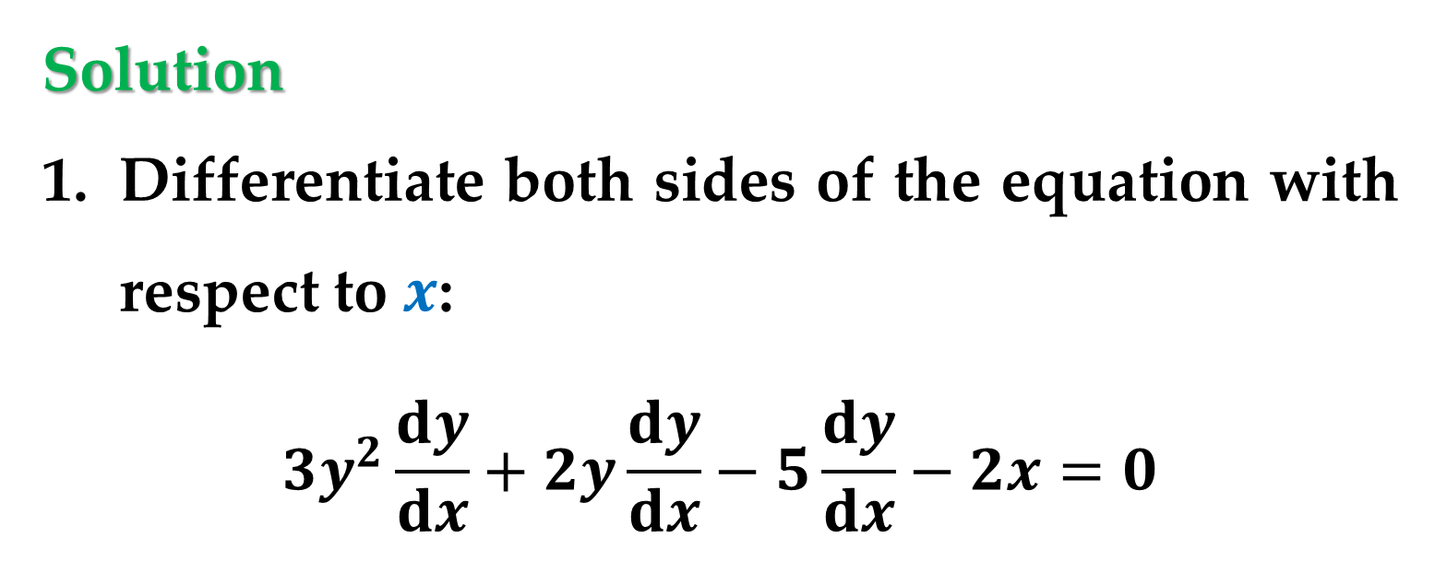
Example 2. Implicit Differentiation
Find $\frac{dy}{dx}$ given that
$$y^{3}+y^{2}−5y−x^{2}=−4$$
Solution
Differentiate both sides of the equation with respect to $x$:
$$3y^{2}\frac{dy}{dx}+2y\frac{dy}{dx}−5\frac{dy}{dx}−2x=0$$

Slide 11
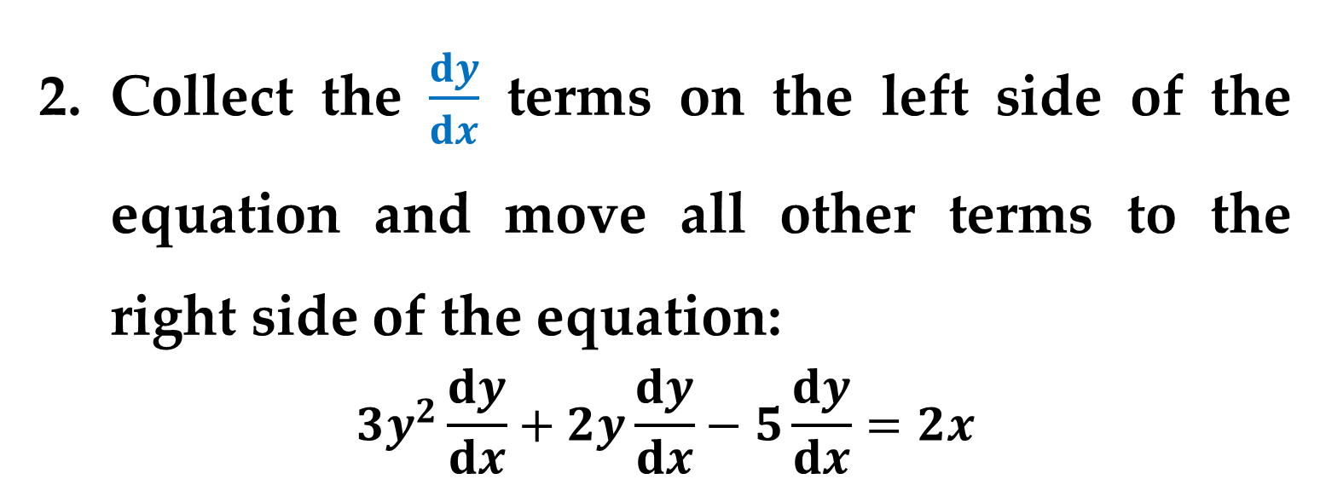
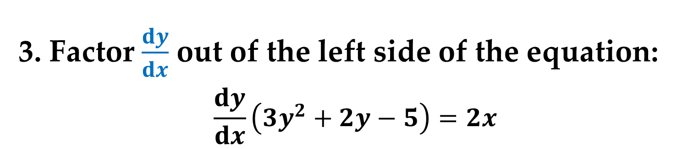
Solution (continued)
Collect the $\frac{dy}{dx}$ terms on the left side of the equation and move all other terms to the right side of the equation:
$$3y^{2}\frac{dy}{dx}+2y\frac{dy}{dx}−5\frac{dy}{dx}=2x$$
3. Factor $\frac{dy}{dx}$ out of the left side of the equation:
$$\frac{dy}{dx}\left(3y^{2}+2y−5\right)=2x$$

Slide 12
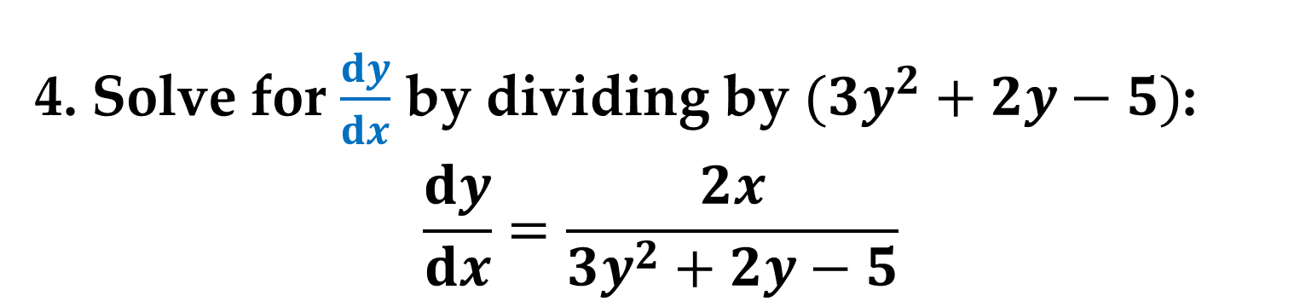
Solution (continued)
4. Solve for $\frac{dy}{dx}$ by dividing by $(3y^{2}+2y−5)$:
$$\frac{dy}{dx}=\frac{2x}{3y^{2}+2y−5}$$

Slide 13
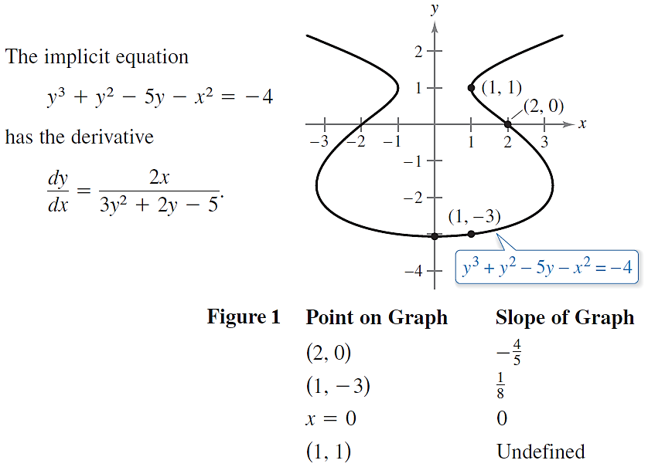
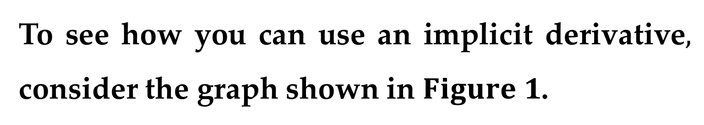
To see how you can use an implicit derivative$,$ consider the graph shown in $Figure 1$.

Slide 14
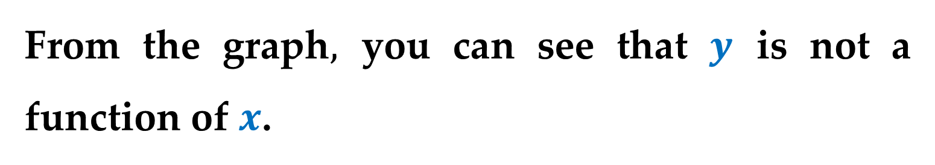
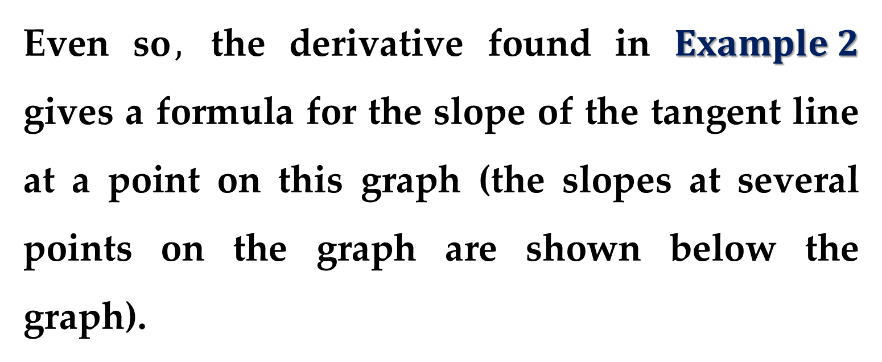
Solution (continued)
From the graph$,$ you can see that $y$ is not a function of $x$.
Even so$,$ the derivative found in $Example 2$ gives a formula for the slope of the tangent line at a point on this graph (the slopes at several points on the graph are shown below the graph).

Slide 15
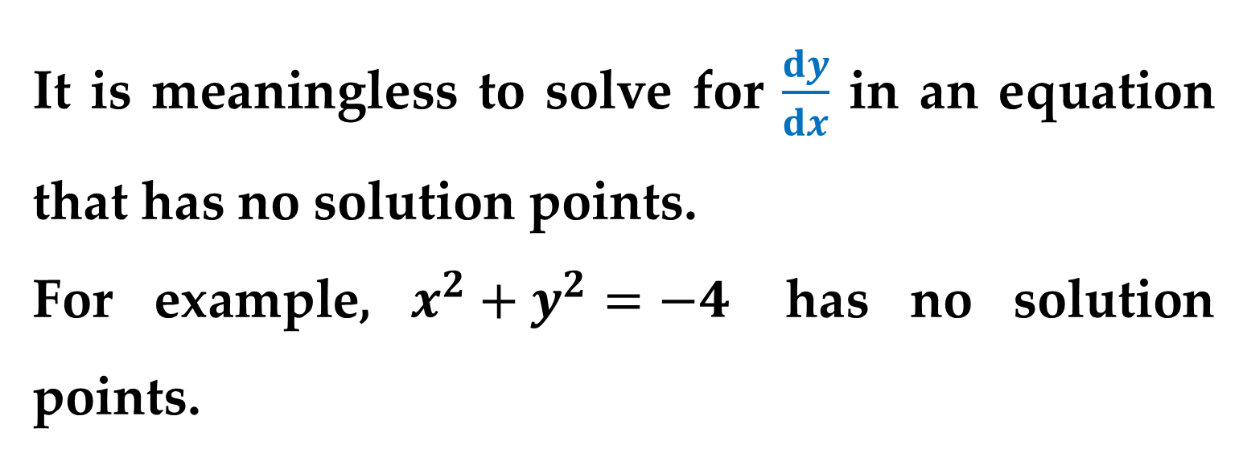
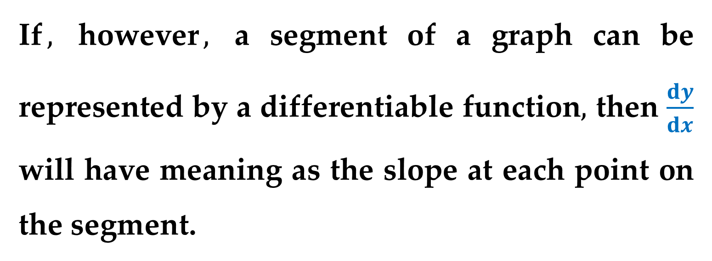
It is meaningless to solve for $\frac{dy}{dx}$ in an equation that has no solution points.
For example, $x^{2}+y^{2}=−4$ has no solution points.
If$,$ however$,$ a segment of a graph can be represented by a differentiable function$,$ then $\frac{dy}{dx}$ will have meaning as the slope at each point on the segment.

Slide 16
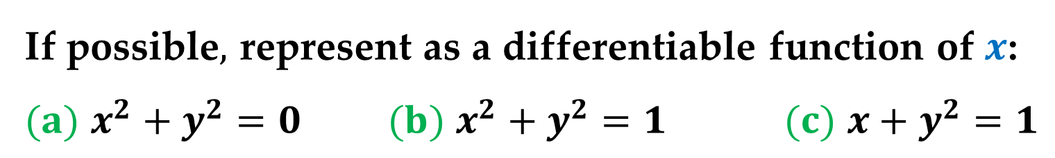
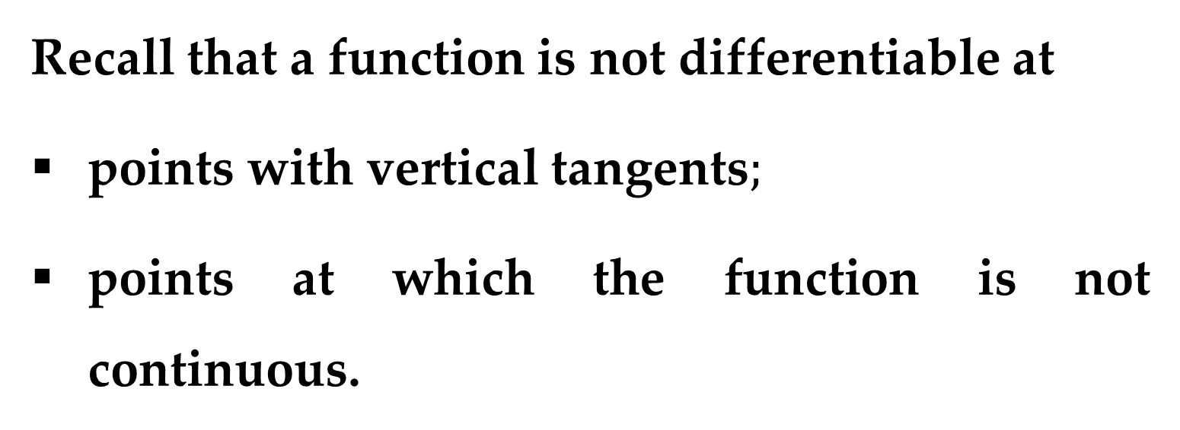
Recall that a function is not differentiable at
points with vertical tangents$;$
points at which the function is not continuous.
Example 3. Graphs and Differentiable
Functions
If possible$,$ represent as a differentiable function of $x$:
$(a)$ $x^{2}+y^{2}=0$ $(b)$ $x^{2}+y^{2}=1$ $(c)$ $x+y^{2}=1$

Slide 17
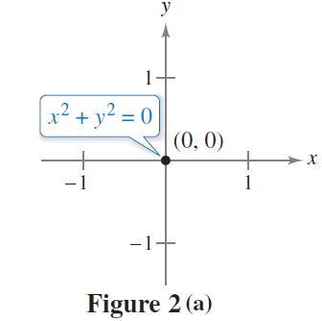
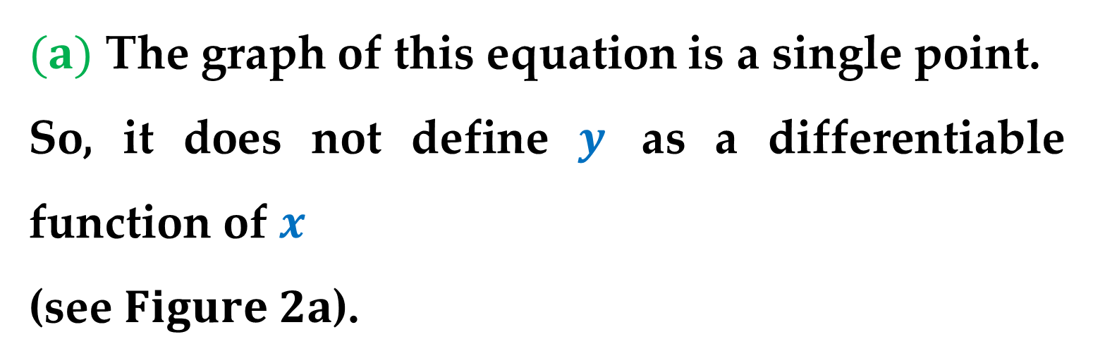
Solution
$(a)$ The graph of this equation is a single point.
So, it does not define $y$ as a differentiable function of $x$
(see $Figure 2a$).

Slide 18
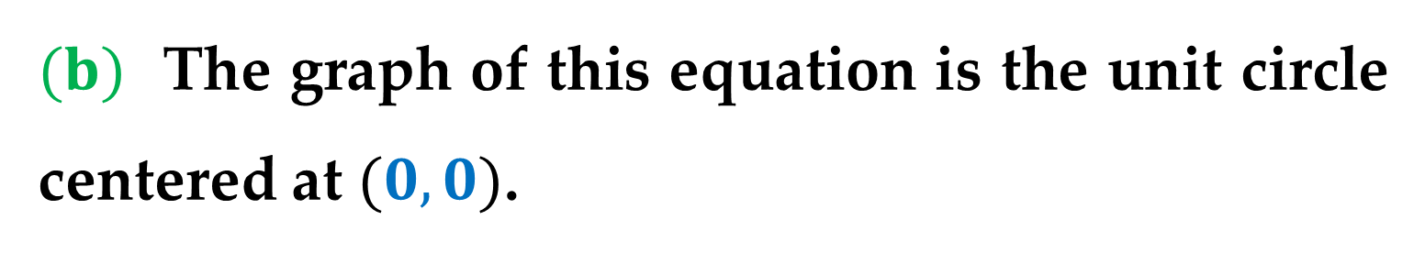
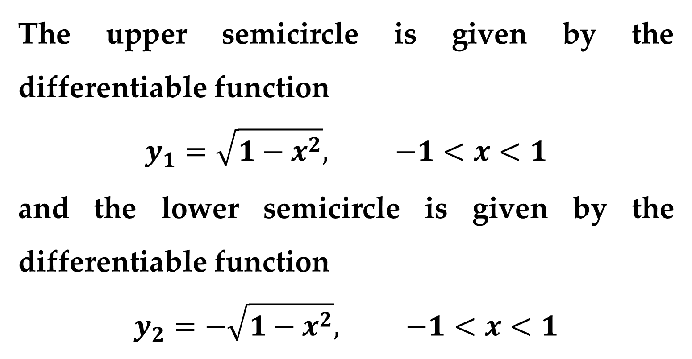
Solution (continued)
$(b)$ The graph of this equation is the unit circle centered at $(0,0)$.
The upper semicircle is given by the differentiable function
$$y_{1}=\sqrt{1−x^{2}}, −1<x<1$$
and the lower semicircle is given by the differentiable function
$$y_{2}=−\sqrt{1−x^{2}}, −1<x<1$$

Slide 19
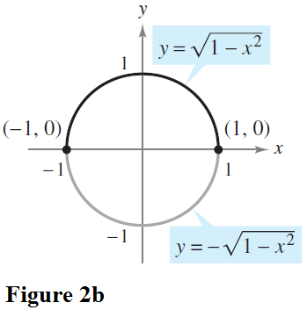
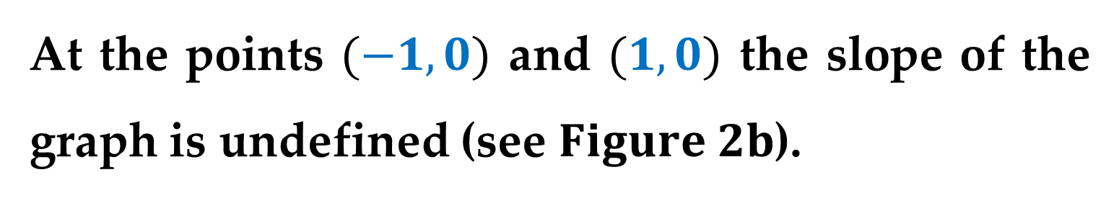
Solution (continued)
At the points $(−1,0)$ and $(1,0)$ the slope of the graph is undefined (see $Figure 2b$).

Slide 20
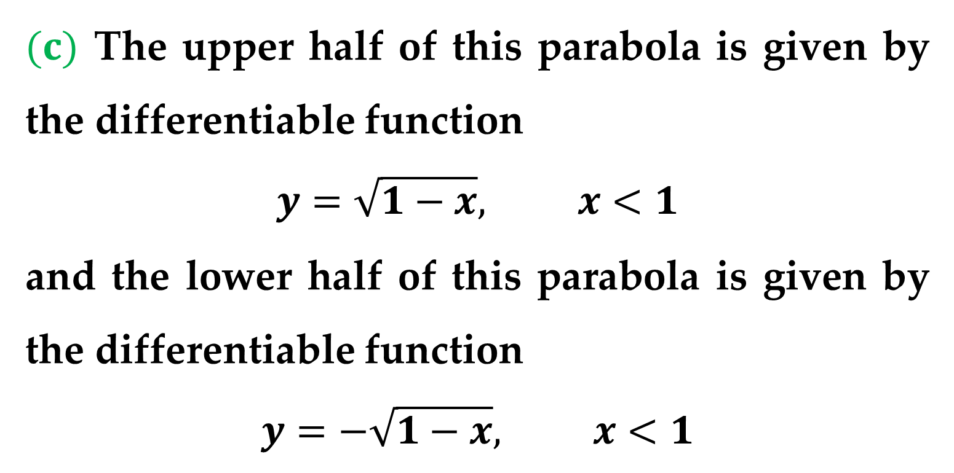
Solution (continued)
$(c)$ The upper half of this parabola is given by the differentiable function
$$y=\sqrt{1−x}, x<1$$
and the lower half of this parabola is given by the differentiable function
$$y=−\sqrt{1−x}, x<1$$

Slide 21
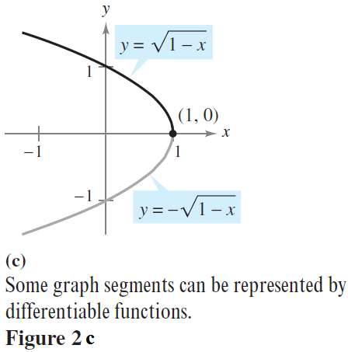
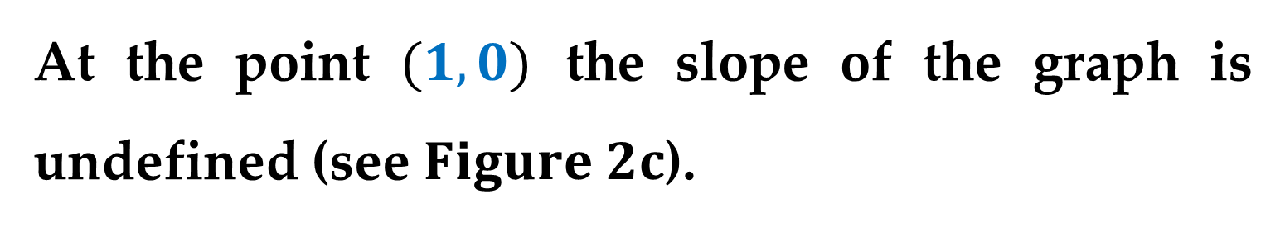
Solution (continued)
At the point $(1,0)$ the slope of the graph is undefined (see $Figure 2c$).

Slide 22
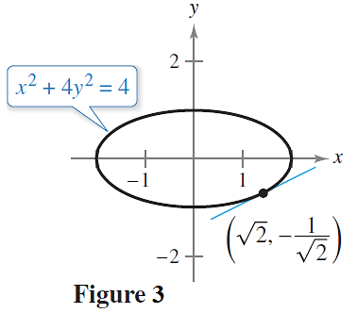
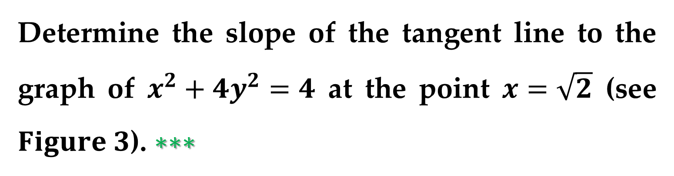
Example 4. Finding the Slope of a Graph
Implicitly
Determine the slope of the tangent line to the graph of $x^{2}+4y^{2}=4$ at the point $x=\sqrt{2}$ (see $Figure 3$). $∗∗∗$

Slide 23
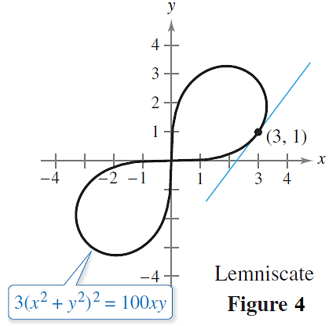
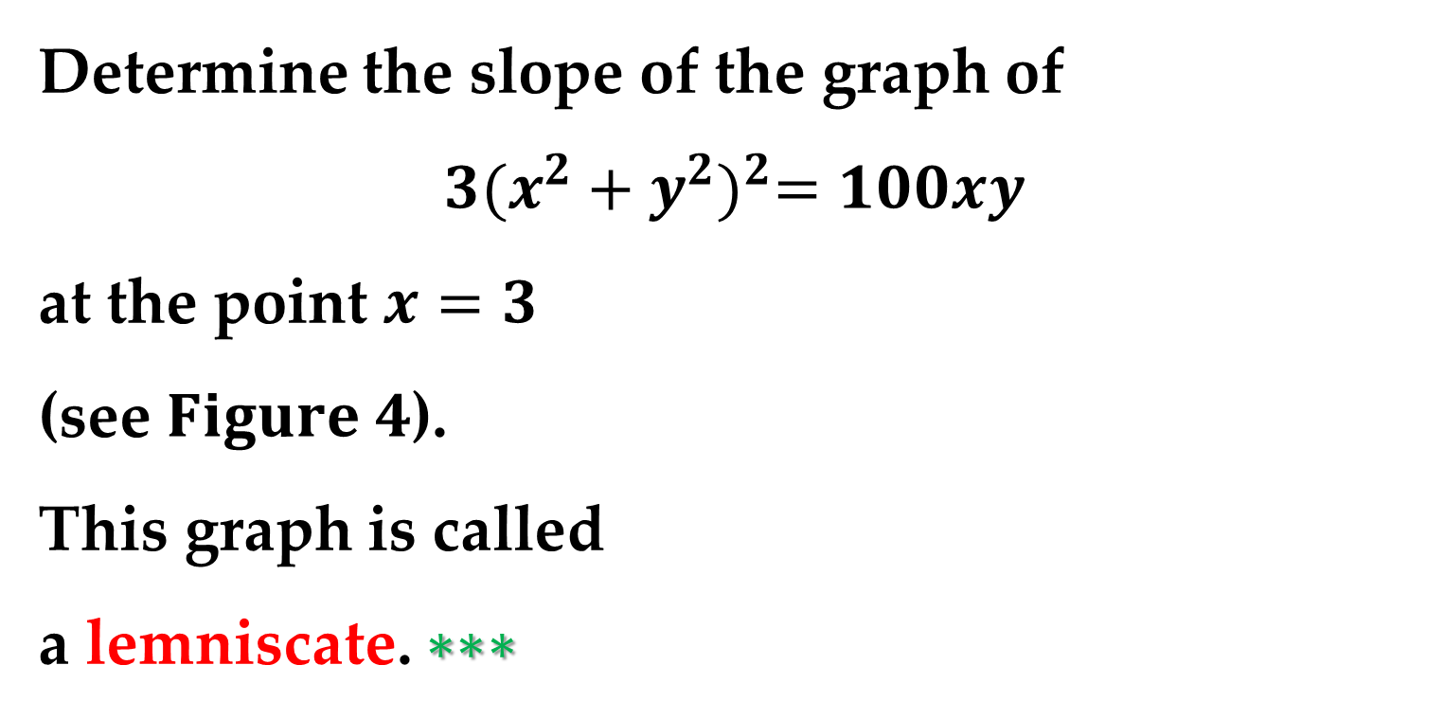
Example 5. Finding the Slope of a Graph
Implicitly
Determine the slope of the graph of
$$3{(x^{2}+y^{2})}^{2}=100xy$$
at the point $x=3$
(see $Figure 4$).
This graph is called
a lemniscate. $∗∗∗$

Slide 24
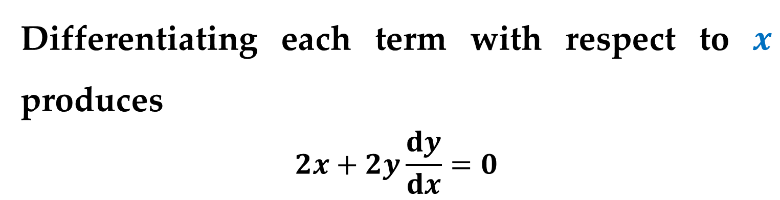


Example 6. Finding the Second Derivative
Given $x^{2}+y^{2}=25,$ find $\frac{d^{2}y}{dx^{2}}$.
Solution
Differentiating each term with respect to $x$ produces
$$2x+2y\frac{dy}{dx}=0$$
$$2y\frac{dy}{dx}=−2x$$
$$\frac{dy}{dx}=−\frac{2x}{2y}=−\frac{x}{y}$$

Slide 25
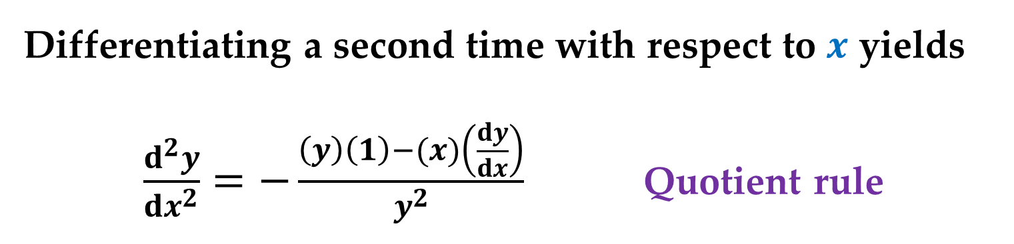
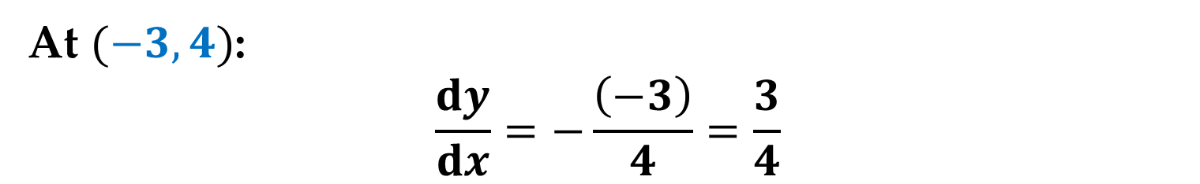
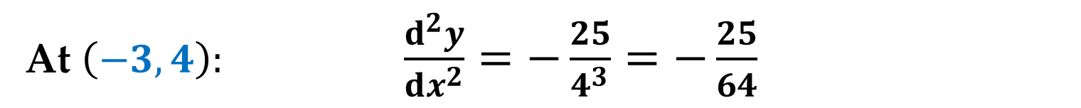

Solution (continued)
At $(−3,4)$:
$$\frac{dy}{dx}=−\frac{\left(−3\right)}{4}=\frac{3}{4}$$
Differentiating a second time with respect to $x$ yields
$\frac{d^{2}y}{dx^{2}}=−\frac{\left(y\right)\left(1\right)−(x)\left(\frac{dy}{dx}\right)}{y^{2}}$ Quotient rule
$$=−\frac{y−\left(x\right)\left(−\frac{x}{y}\right) }{y^{2}}=−\frac{y^{2}+x^{2}}{y^{3}}$$
At $\left(−3,4\right):$ $\frac{d^{2}y}{dx^{2}}=−\frac{25}{4^{3}}=−\frac{25}{64}$

Slide 26
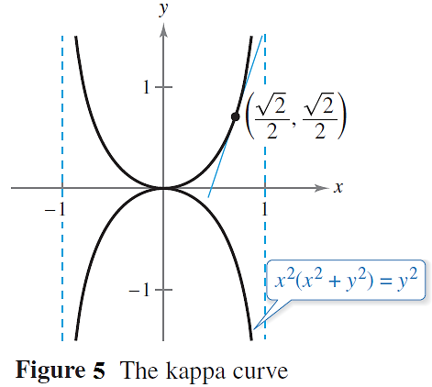
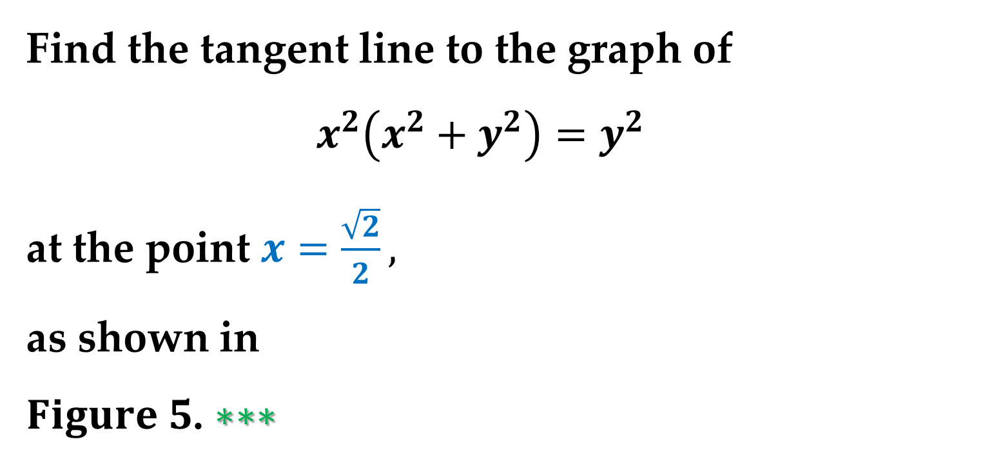
Example 7. Finding a Tangent Line to a Graph
Find the tangent line to the graph of
$x^{2}\left(x^{2}+y^{2}\right)=y^{2}$
at the point $x=\frac{\sqrt{2}}{2},$
as shown in
$Figure 5$. $∗∗∗$

Slide 27
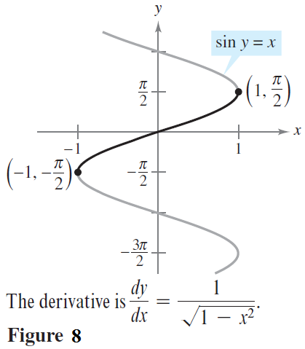
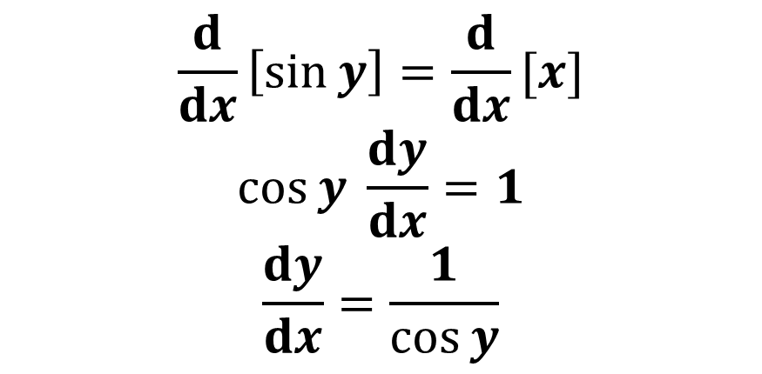
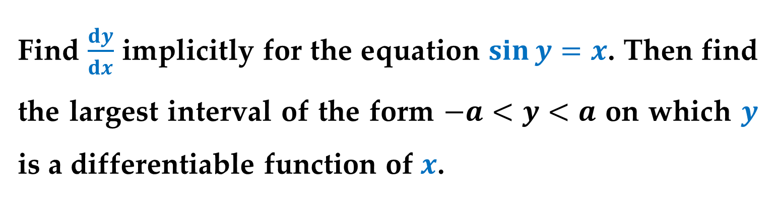
Example 8. Determining a Differentiable
Function
Find $\frac{dy}{dx}$ implicitly for the equation $\sin{y}=x$. Then find the largest interval of the form $−a<y<a$ on which $y$ is a differentiable function of $x$.
Solution
$$\frac{d}{dx}\left[\sin{y}\right]=\frac{d}{dx}[x]$$
$$\cos{y} \frac{dy}{dx}=1$$
$$\frac{dy}{dx}=\frac{1}{\cos{y}}$$

Slide 28
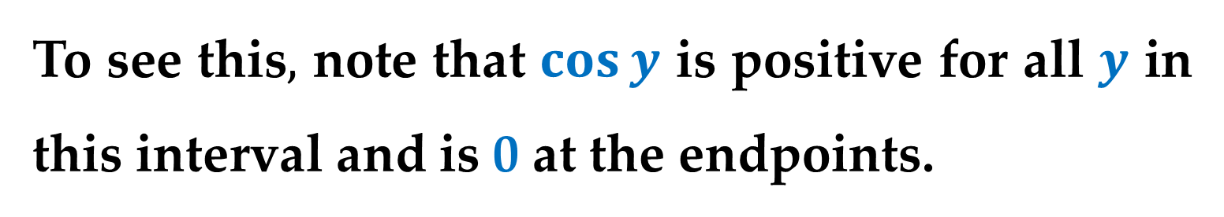
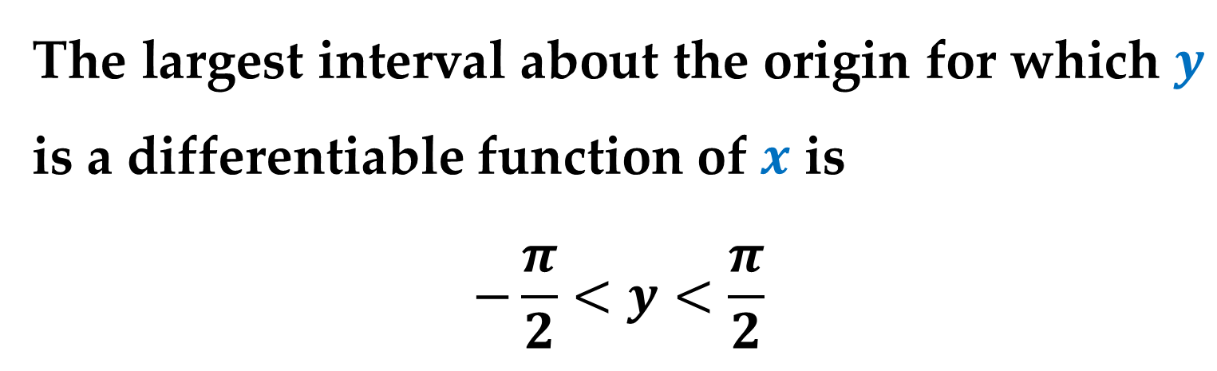
Solution (continued)
The largest interval about the origin for which $y$ is a differentiable function of $x$ is
$$−\frac{π}{2}<y<\frac{π}{2}$$
To see this$,$ note that $\cos{y}$ is positive for all $y$ in this interval and is 0 at the endpoints.

Slide 29
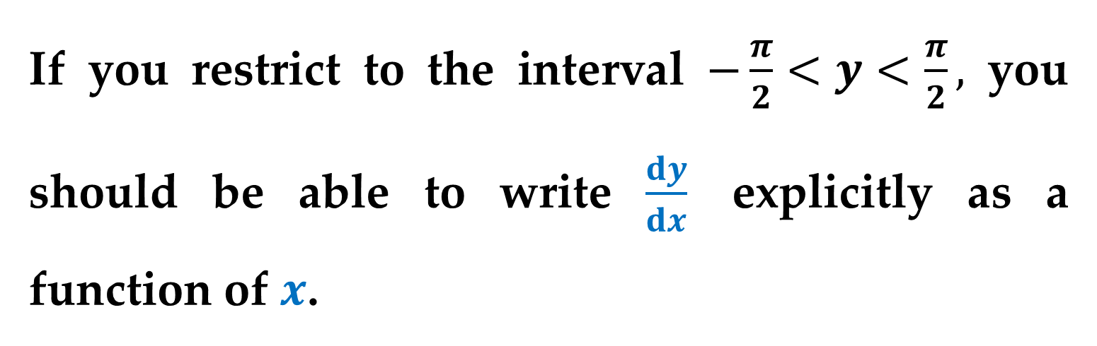
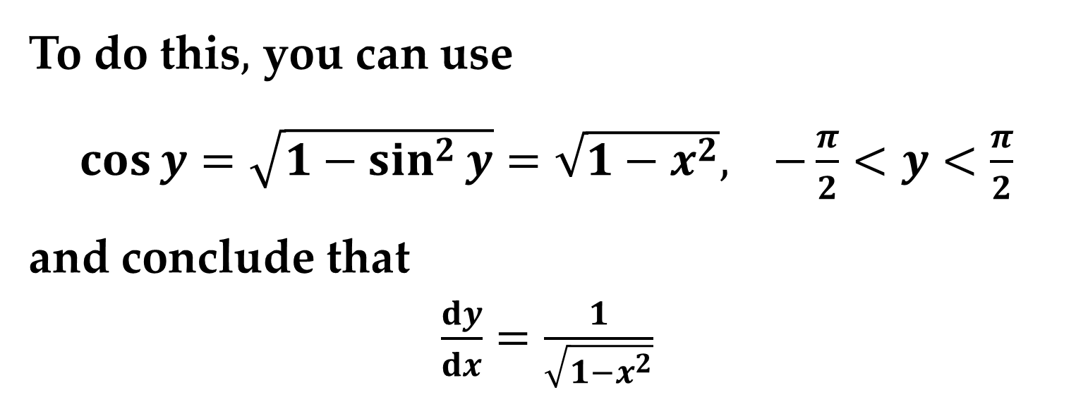
Solution (continued)
If you restrict to the interval $−\frac{π}{2}<y<\frac{π}{2},$ you should be able to write $\frac{dy}{dx}$ explicitly as a function of $x$.
To do this$,$ you can use
$\cos{y}=\sqrt{1−\sin^{2}{y}}=\sqrt{1−x^{2}}, −\frac{π}{2}<y<\frac{π}{2}$
and conclude that
$\frac{dy}{dx}=\frac{1}{\sqrt{1−x^{2}}}$

Slide 30
Thank you for attention

